Slide 1
TapPrints: Your Finger Taps Have Fingerprints
Emiliano Miluzzo*, Alex Varshavsky*, Suhrid Balakrishnan*, Romit R. Choudhury⁺
*at&t Labs – Research, USA ⁺Duke University, USA

Slide 2
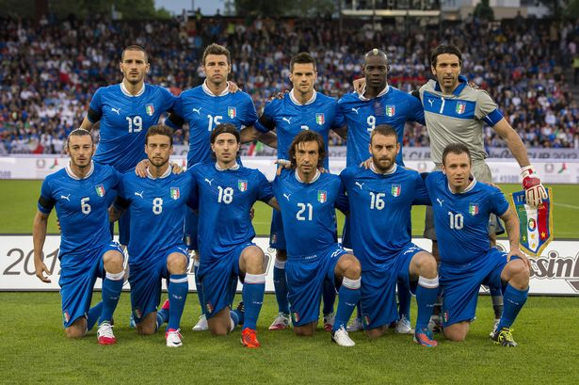
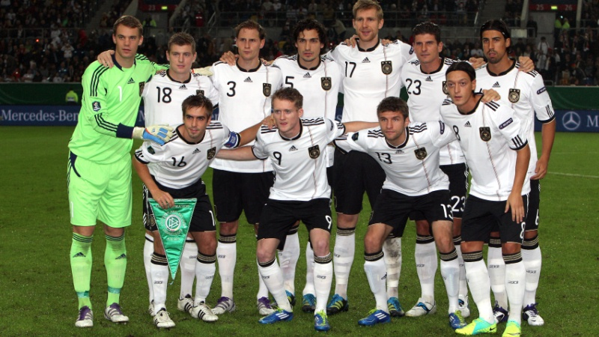
Vs

Slide 3
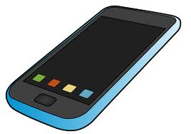
sensing with smartphones and tablets
gyroscope
accelerometer
compass
compass
barometer
location
compass

Slide 4
sensing with smartphones and tablets

Slide 5
sensing with smartphones and tablets

Slide 6
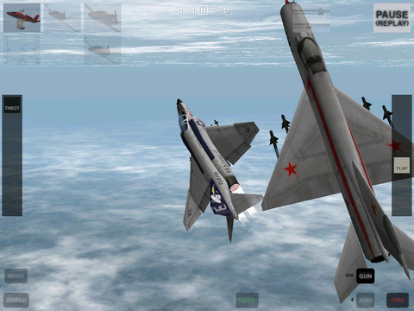
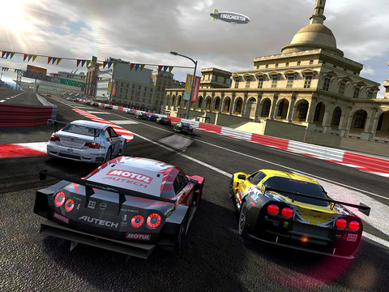
what is sensing used for?

Slide 7
what is sensing used for?

Slide 8
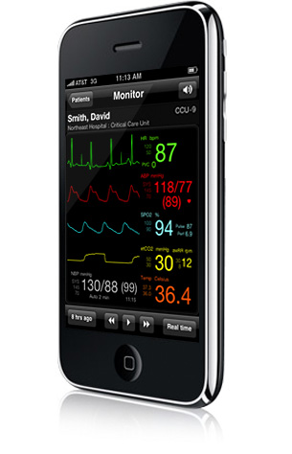
what is sensing used for?

Slide 9
what is sensing used for?

Slide 10
however…

Slide 11
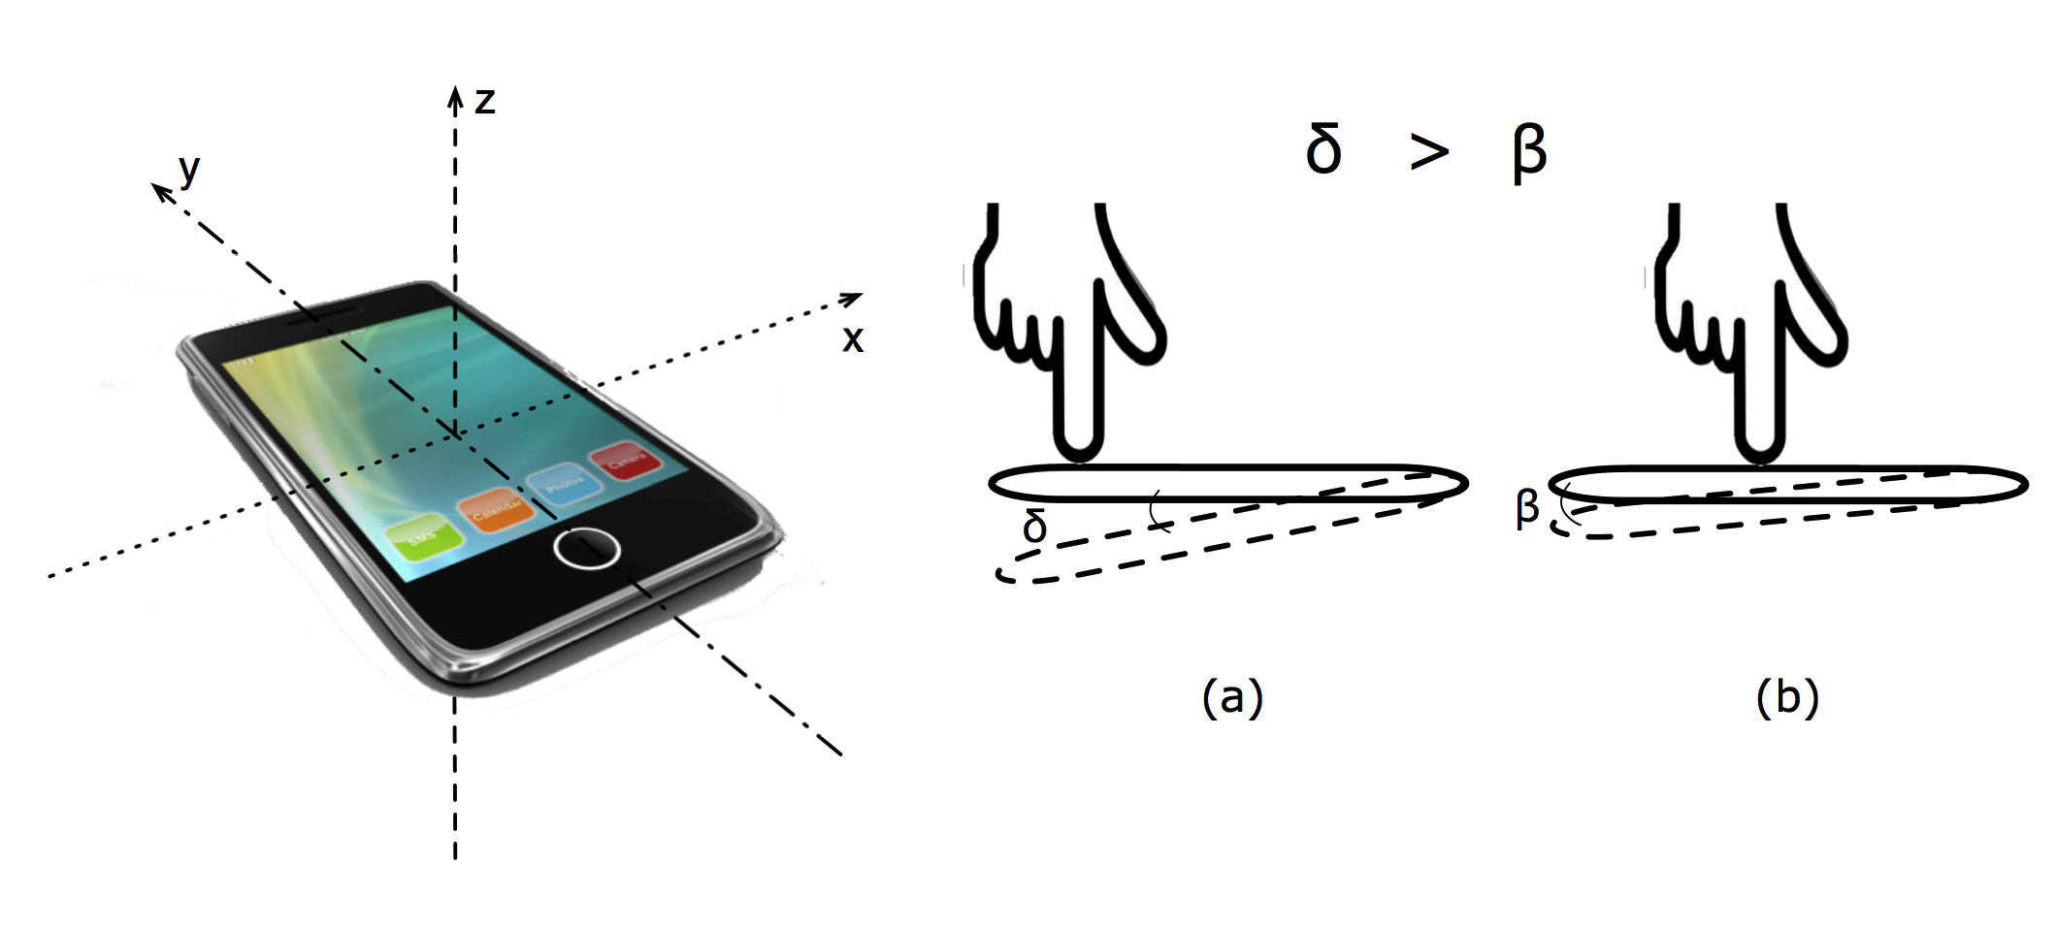

Slide 14
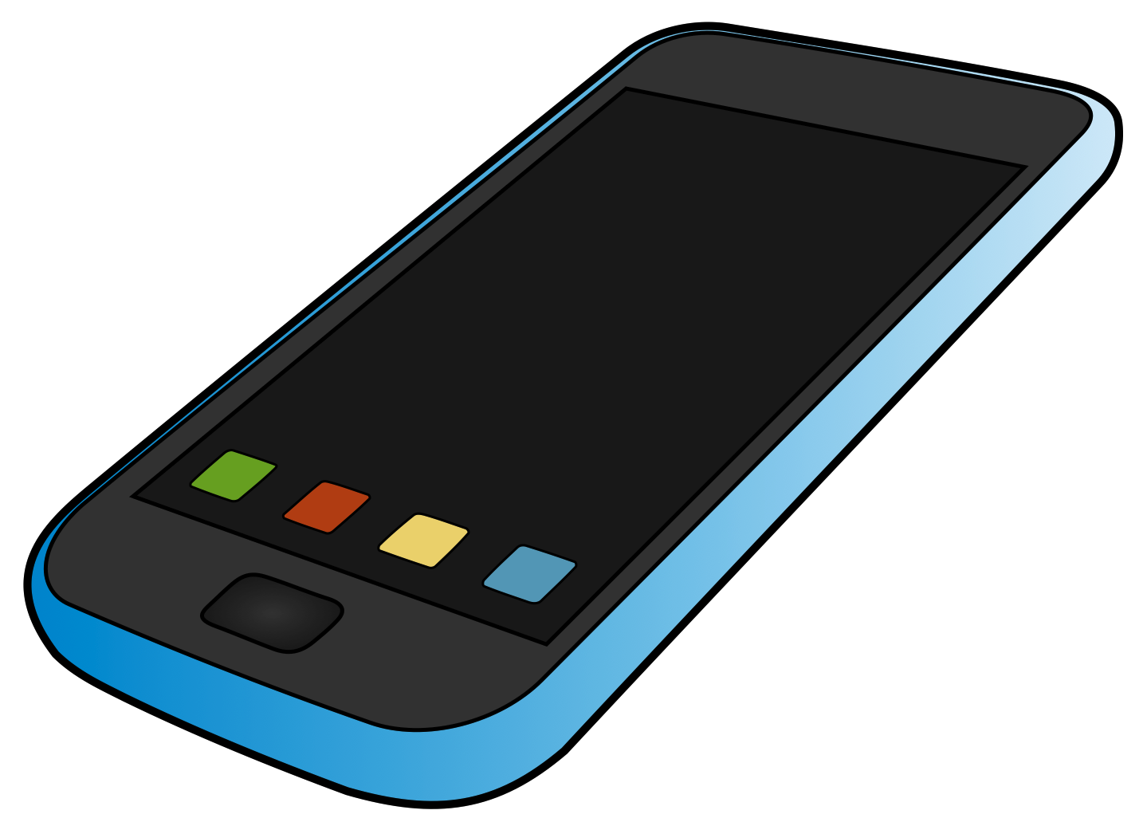
x₁, y₁

Slide 15
x₂, y₂

Slide 16
x₃, y₃

Slide 18
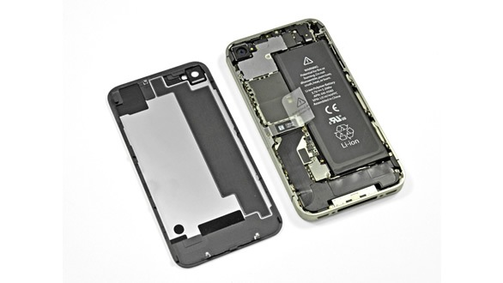

Slide 20
facts
motion sensors do not require user permission
motion sensors can run in the background
W3C proposal for motion sensor data access with Javascript

Slide 21
threat model
legitimate apps exploiting motion sensor data for malicious purposes
malicious apps secretly installed
web app access to motion sensors

Slide 22
practical scenario

Slide 23
practical scenario
accel and gyro data from N people

Slide 24
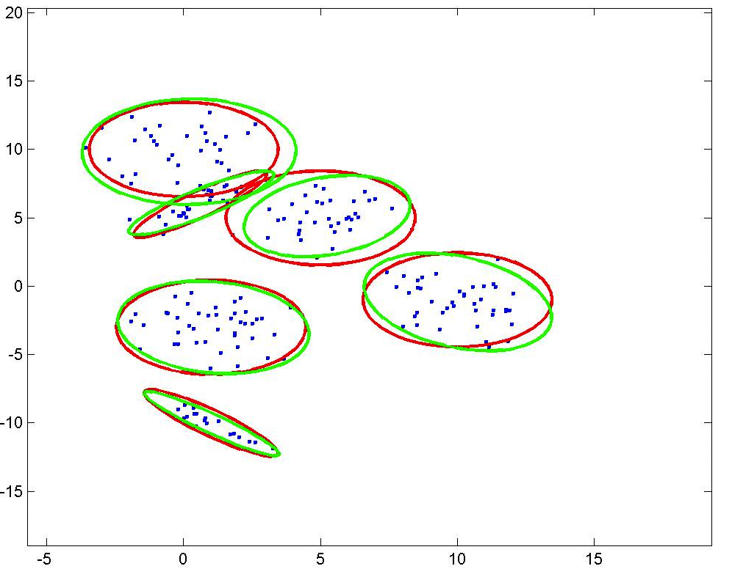
practical scenario
accel and gyro data from N people
build a model for the keys

Slide 25
practical scenario
accel and gyro data from N people
build a model for the keys
deploy app + model

Slide 26
z

Slide 27
p

Slide 28
design

Slide 30
how do we model the taps so that we can recognize them?

Slide 31
ML approach
accel and gyro data from N people
build a model for the keys
deploy app + model

Slide 32
ML approach
accel and gyro data from N people
build a model for the keys
deploy app + model

Slide 33
ML approach
accel and gyro data from N people
build a model for the keys
deploy app + model

Slide 34
ML approach
accel and gyro data from N people
build a model for the keys
deploy app + model

Slide 35
ML approach

Slide 36
ML approach

Slide 37
ML approach

Slide 38
ML approach
M-class classifier
(M=26 for letters)

Slide 39
ML approach

Slide 40
features

Slide 41
features
time domain
moments, variance, min/max, skewness (for asymmetry of vector components), kurtosis (to measure the ‘peaked-ness’ of vector components)
correlation between the 3-axis of both the accelerometer and gyro using different norms
first-order numerical derivatives and energy
angle between the accelerometer and gyro vector and the rate of change
frequency domain
fast fourier transform, power, etc.

Slide 42
learning
classifiers
kNN, SVM, multinomial logistic regression, random forest, bagged decision tree
ensemble method
21 classifiers and the final result is given from the most predicted vote

Slide 43
experimental results

Slide 44
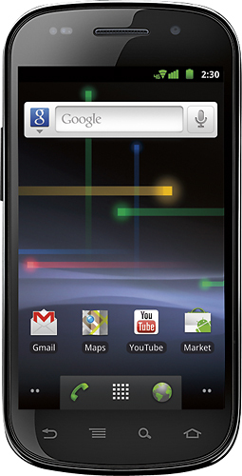
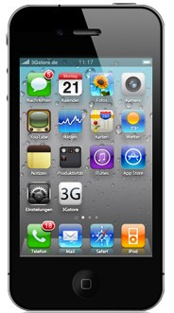
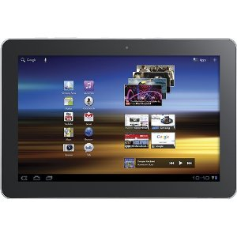

Slide 45
methodology
10 volunteers
~40.000 labeled taps
4 weeks
portrait thumb, portrait index finger, landscape both thumbs
They are asked to press
icons
letters sequentially
pangrams

Slide 46
icon tap experiment

Slide 47
icon tap experiment
random guess inference accuracy

Slide 48
icon tap experiment

Slide 49
icon tap experiment

Slide 50
icon tap experiment

Slide 51
icon tap experiment

Slide 52
icon tap experiment

Slide 53
borrowing strength
is a pre-trained model enough to infer taps in the wild?

Slide 54
borrowing strength
given N users, train on N-1 users and test on the left-out user

Slide 55
borrowing strength

Slide 56
borrowing strength

Slide 57
borrowing strength

Slide 58
borrowing strength

Slide 59
borrowing strength

Slide 60
borrowing strength

Slide 61
borrowing strength

Slide 62
letter press - tablet

Slide 63
letter press - tablet
random guess inference accuracy

Slide 64
letter press - tablet

Slide 65
letter press - tablet

Slide 66
letter press - tablet

Slide 67
pangram - tablet

Slide 68
pangram - tablet
the quick brown fox jumps over the lazy dog

Slide 69
pangram - tablet

Slide 70
pangram - tablet

Slide 71
pangram - tablet

Slide 72
pangram - tablet

Slide 73
pangram - tablet
r, w, s, a

Slide 74
pangram - tablet

Slide 75
letter press - phone
avg accuracy between
37% and 66%

Slide 76
pangram - phone

Slide 77
pangram - phone

Slide 78
pangram - phone

Slide 79
pangram - phone
dictionary attacks combined with confusion matrix prior could boost the accuracy

Slide 80
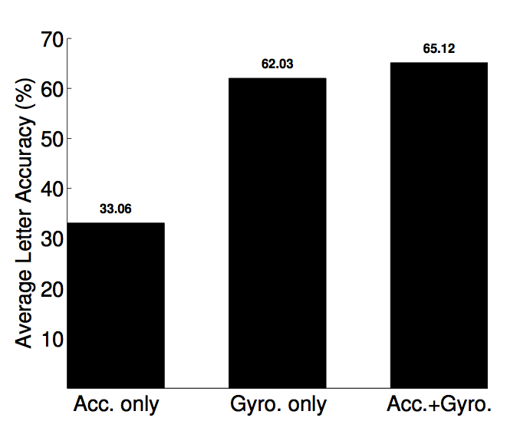
most effective sensor?

Slide 81
most effective sensor?

Slide 82
most effective sensor?

Slide 83
most effective sensor?

Slide 84
sensor sampling rate plays a role

Slide 85
possible solutions?
block motion sensor data when the keyboard is up
reduce motion sensors’ sampling rate for an app running in the background
review the W3C draft for motion sensor access through Javascript?

Slide 86
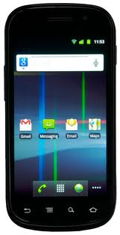
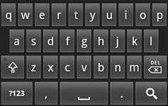
possible solutions?

Slide 87
future work
exploiting tap inference to profile a user’s behavior (to identify the device legitimate user for example)?

Slide 88
to tap or not to tap, that is the question… ☺ miluzzo@research.att.com

