Slide 1
Darwin Phones: the Evolution of Sensing and Inference on Mobile Phones
Emiliano Miluzzo*, Cory T. Cornelius*, Ashwin Ramaswamy*, Tanzeem Choudhury*, Zhigang Liu**,
Andrew T. Campbell*
* CS Department – Dartmouth College
** Nokia Research Center – Palo Alto

Slide 2
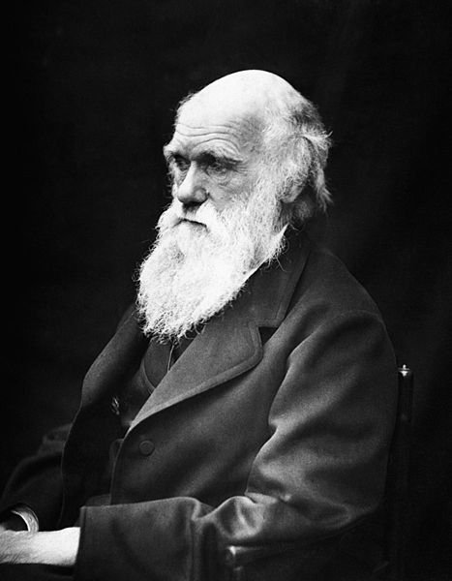
Emiliano Miluzzo

Slide 3
evolution of sensing and inference
on mobile phones
Emiliano Miluzzo

Slide 4
PR time
Emiliano Miluzzo

Slide 5
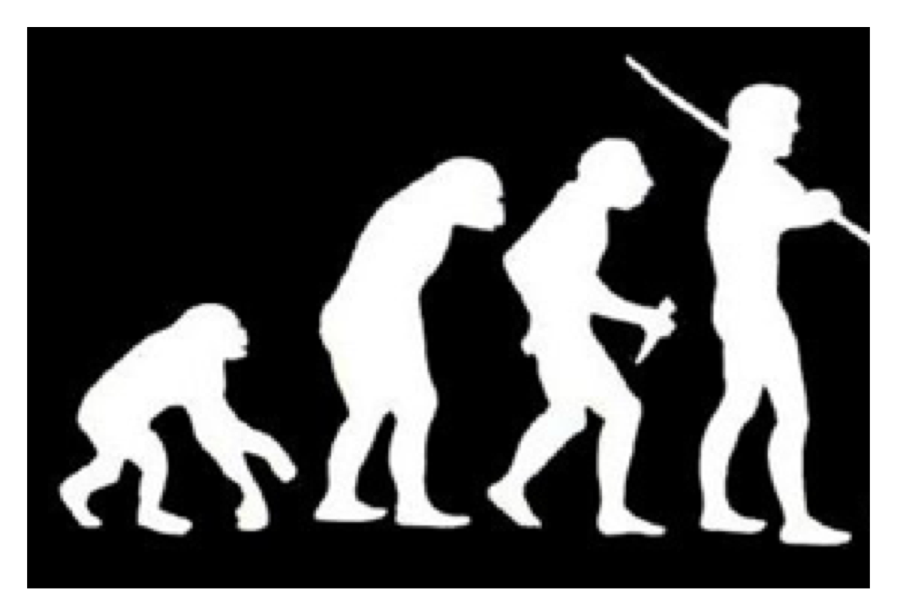
Emiliano Miluzzo

Slide 6
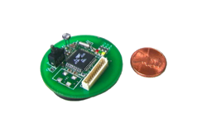
Emiliano Miluzzo

Slide 7
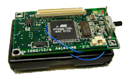
Emiliano Miluzzo

Slide 8
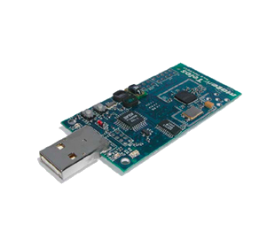
Emiliano Miluzzo

Slide 9
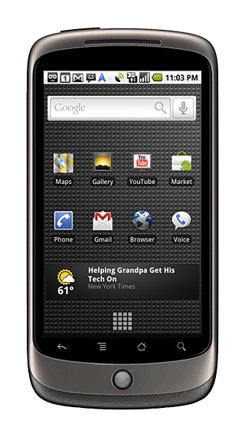
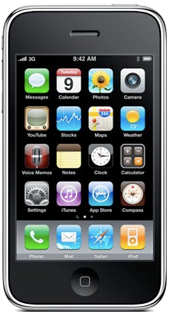
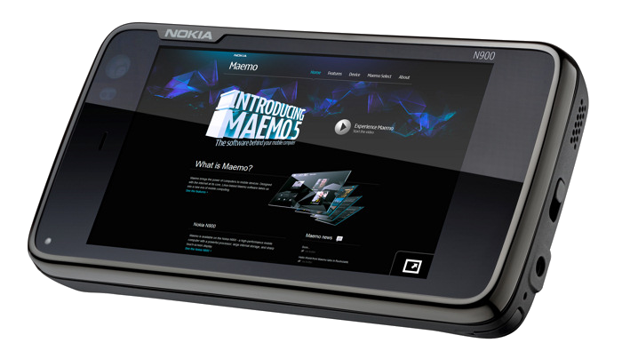
Emiliano Miluzzo

Slide 10
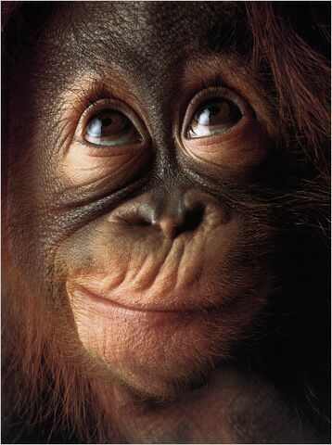
ok… so what ??
Emiliano Miluzzo

Slide 11
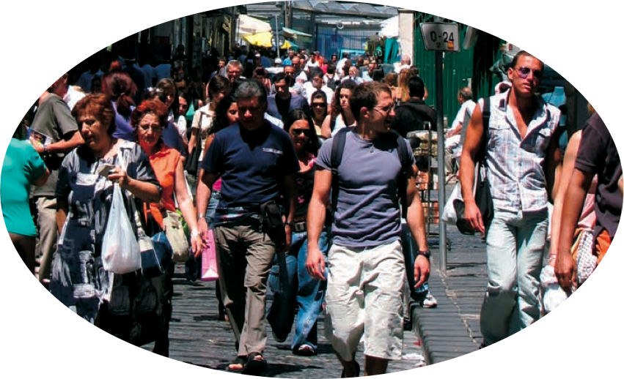
density
Emiliano Miluzzo

Slide 12
sensing
accelerometer
….
digital compass
microphone
light sensor/camera
GPS
WiFi/bluetooth
Emiliano Miluzzo

Slide 13
sensing
….
accelerometer
air quality /
pollution sensor
digital compass
gyroscope
microphone
light sensor/camera
GPS
WiFi/bluetooth
Emiliano Miluzzo

Slide 14
programmability
free SDK
- multitasking
Emiliano Miluzzo

Slide 15
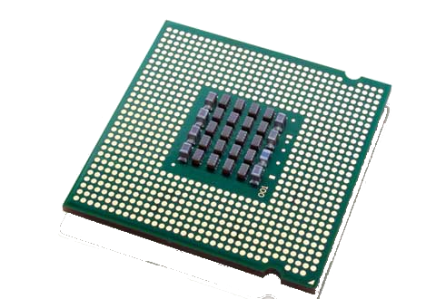
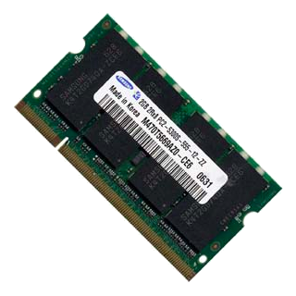
hardware
- 600 MHz CPU
- up to 1GB
application memory
computation capability is increasing
Emiliano Miluzzo

Slide 16


application distribution
Emiliano Miluzzo

Slide 17
application distribution
deploy apps onto millions of phones at the blink of an eye
Emiliano Miluzzo

Slide 18
application distribution
deploy apps onto millions of phones at the blink of an eye
collect huge amount of data for research purposes
Emiliano Miluzzo

Slide 19
cloud infrastructure
cloud - backend support
Emiliano Miluzzo

Slide 20
cloud infrastructure
cloud - backend support
Emiliano Miluzzo

Slide 21
cloud infrastructure
cloud - backend support
we want to push intelligence to the phone
Emiliano Miluzzo

Slide 22
cloud infrastructure
cloud - backend support
preserve the phone user experience
(battery lifetime, ability to make calls, etc.)
Emiliano Miluzzo

Slide 23
cloud infrastructure
cloud - backend support
sensing
run machine learning algorithms locally (feature extraction + inference)
Emiliano Miluzzo

Slide 24
cloud infrastructure
cloud - backend support
run machine learning
algorithms
(learning)
sensing
run machine learning algorithms locally (feature extraction + inference)
Emiliano Miluzzo
Notes:
.

Slide 25
cloud infrastructure
cloud - backend support
run machine learning
algorithms
(learning)
store and crunch
big data
(fusion)
sensing
run machine learning algorithms locally (feature extraction + inference)
Emiliano Miluzzo

Slide 26

cloud infrastructure
cloud - backend support
run machine learning
algorithms
(learning)
store and crunch
big data
(fusion)
3 to 5 years from now our phones will be as powerful as a
sensing
run machine learning algorithms locally (feature extraction + inference)
Emiliano Miluzzo

Slide 27
cloud infrastructure
cloud - backend support
run machine learning
algorithms
(learning)
store and crunch
big data
(fusion)
3 to 5 years from now our phones will be as powerful as a
sensing
run machine learning algorithms locally (feature extraction + inference)
Emiliano Miluzzo

Slide 28
cloud infrastructure
cloud - backend support
run machine learning
algorithms
(learning)
store and crunch
big data
(fusion)
3 to 5 years from now our phones will be as powerful as a
sensing
run machine learning algorithms locally (feature extraction + inference)
Emiliano Miluzzo

Slide 29
cloud infrastructure
cloud - backend support
run machine learning
algorithms
(learning)
store and crunch
big data
(fusion)
3 to 5 years from now our phones will be as powerful as a
Sensing
run machine learning algorithms locally
(feature extraction + learning + inference)
Emiliano Miluzzo

Slide 30
programmability
sensing
cloud infrastructure
Emiliano Miluzzo

Slide 31
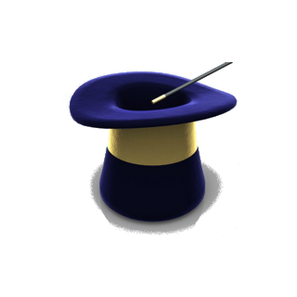
programmability
sensing
??
cloud infrastructure
Emiliano Miluzzo

Slide 32
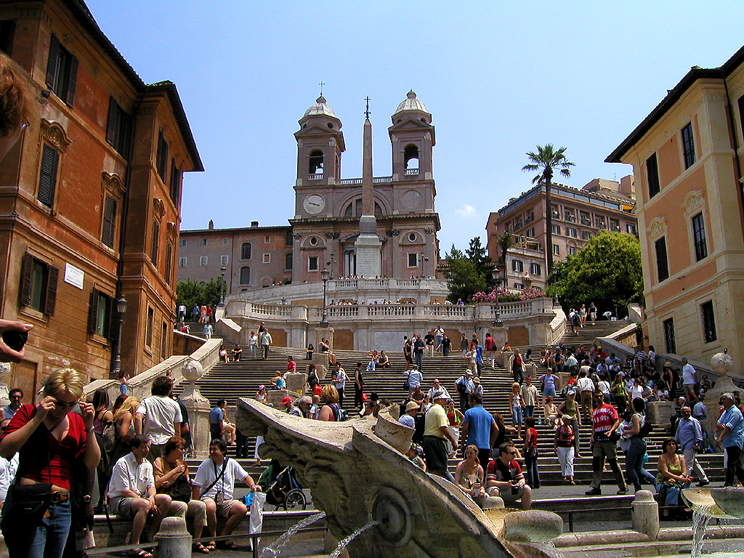
societal scale sensing
reality mining using mobile phones
will play a big role in the future
global mobile sensor network
Emiliano Miluzzo

Slide 33
end of PR – now darwin
Emiliano Miluzzo

Slide 34
a small building block towards the big vision
Emiliano Miluzzo

Slide 35
from motes to mobile phones
Emiliano Miluzzo

Slide 36
from motes to mobile phones
evolution of sensing and inference
on mobile phones
Emiliano Miluzzo

Slide 37
from motes to mobile phones
evolution of sensing and inference
on mobile phones
classification model
evolution
darwin
classification model
pooling
collaborative
inference
Emiliano Miluzzo

Slide 38
sensing
darwin
apps
microphone
social context
classification model
evolution
camera
classification model
pooling
audio / pollution / RF
fingerprinting
GPS/WiFi/
cellular
air quality
pollution
collaborative
inference
image / video
manipulation
darwin applies distributed computing and collaborative inference concepts to
mobile sensing systems
Emiliano Miluzzo

Slide 39
why darwin?
mobile phone sensing today
Emiliano Miluzzo

Slide 40
why darwin?
mobile phone sensing today
train classification
model X in the lab
Emiliano Miluzzo

Slide 41
why darwin?
mobile phone sensing today
train classification
model X in the lab
deploy classifier X
Emiliano Miluzzo

Slide 42
why darwin?
mobile phone sensing today
train classification
model X in the lab
deploy classifier X
train classification
model X’ in the lab
Emiliano Miluzzo

Slide 43
why darwin?
mobile phone sensing today
train classification
model X in the lab
deploy classifier X
train classification
model X’ in the lab
deploy classifier X’
Emiliano Miluzzo

Slide 44
why darwin?
mobile phone sensing today
a fully supervised approach doesn’t scale!
train classification
model X in the lab
deploy classifier X
train classification
model X’ in the lab
deploy classifier X’
Emiliano Miluzzo

Slide 45

why darwin?
a same classifier does not scale to multiple environments (e.g., quiet and noisy env)
Emiliano Miluzzo

Slide 46
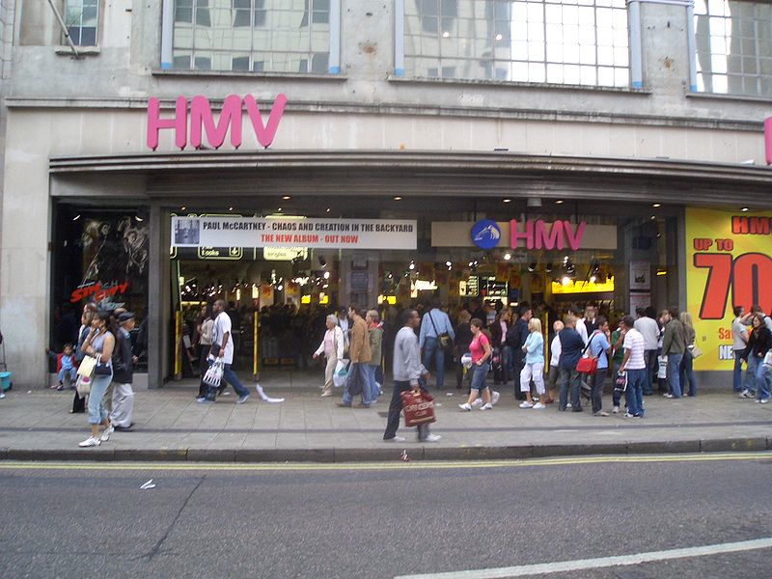
why darwin?
a same classifier does not scale to multiple environments (e.g., quiet and noisy env)
Emiliano Miluzzo

Slide 47
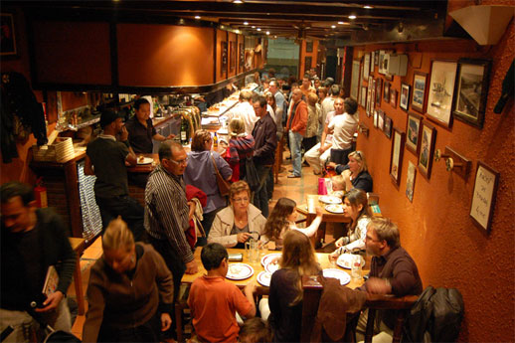
why darwin?
a same classifier does not scale to multiple environments (e.g., quiet and noisy env)
Emiliano Miluzzo

Slide 48
why darwin?
a same classifier does not scale to multiple environments (e.g., quiet and noisy env)
darwin creates new classification models transparently from the user
(classification model evolution)
Emiliano Miluzzo

Slide 49
why darwin?
ability for an application to
rapidly scale to many devices
Emiliano Miluzzo

Slide 50
why darwin?
darwin re-uses classification models when possible
(classification model pooling)
ability for an application to
rapidly scale to many devices
Emiliano Miluzzo

Slide 51
why darwin?
leverage the large
ensemble of in-situ resources
Emiliano Miluzzo

Slide 52
why darwin?
darwin exploits spatial diversity and co-operate to alleviate the “sensing context” problem
(collaborative inference)
leverage the large
ensemble of in-situ resources
Emiliano Miluzzo

Slide 53
darwin design
Emiliano Miluzzo

Slide 54
speaker recognition
(subject to audio noise, sensing context, etc.)
Emiliano Miluzzo

Slide 55
darwin phases
Emiliano Miluzzo

Slide 56
darwin phases
supervised
initial training (derive model seed)
Emiliano Miluzzo

Slide 57
darwin phases
supervised
initial training (derive model seed)
unsupervised
classification model evolution
Emiliano Miluzzo

Slide 58
darwin phases
supervised
initial training (derive model seed)
unsupervised
classification model evolution
classification model pooling
Emiliano Miluzzo

Slide 59
darwin phases
supervised
initial training (derive model seed)
unsupervised
classification model evolution
classification model pooling
collaborative inference
Emiliano Miluzzo

Slide 60
classification model training
sensed event
Emiliano Miluzzo

Slide 61
classification model training
filtering (silence suppression + voicing)
sensed event
Emiliano Miluzzo

Slide 62
classification model training
filtering (silence suppression + voicing)
feature
extraction
(MFCC)
sensed event
Emiliano Miluzzo

Slide 63

classification model training
send MFCC to
backend to train the model
backend
send model +
baseline back to phone
model
filtering (silence suppression + voicing)
feature
extraction
(MFCC)
model
training
(GMM)
baseline
sensed event
Emiliano Miluzzo

Slide 64
classification model training
backend
phone: feature extraction
(low computation)
backend: model training
(high computation)
Emiliano Miluzzo

Slide 65
classification model evolution
phone: determines when to evolve
Emiliano Miluzzo

Slide 66
classification model evolution
training
phone: determines when to evolve
Emiliano Miluzzo

Slide 67
classification model evolution
training
sampled
phone: determines when to evolve
Emiliano Miluzzo

Slide 68
classification model evolution
match?
YES
phone: determines when to evolve
do not evolve
Emiliano Miluzzo

Slide 69
classification model evolution
match?
NO
phone: determines when to evolve
evolve
(train new model using backend as before)
Emiliano Miluzzo

Slide 70
classification model evolution
training
new speaker voice model
Emiliano Miluzzo

Slide 71
classification model evolution
training
new speaker voice model
Emiliano Miluzzo

Slide 72
classification model evolution
training
new speaker voice model
Emiliano Miluzzo

Slide 73
classification model pooling
Emiliano Miluzzo

Slide 74
classification model pooling
Phone A
Phone B
Speaker A’s model
Speaker B’s model
Speaker B’s model
Speaker C’s model
Speaker C’s model
Phone C
Emiliano Miluzzo

Slide 75
classification model pooling
Phone A
Phone B
we have two options
Speaker A’s model
1. train a new classifier for each speaker (costly for power, inference delay)
Speaker B’s model
Speaker B’s model
Speaker C’s model
Speaker C’s model
Phone C
Emiliano Miluzzo

Slide 76
classification model pooling
Phone A
Phone B
we have two options
Speaker A’s model
1. train a new classifier for each speaker (costly for power, inference delay)
Speaker B’s model
Speaker B’s model
2. re-use already available classifiers
Speaker C’s model
Speaker C’s model
Phone C
Emiliano Miluzzo

Slide 77
classification model pooling
Phone A
Phone B
we have two options
Speaker A’s model
1. train a new classifier for each speaker (costly for power, inference delay)
Speaker B’s model
Speaker B’s model
2. re-use already available classifiers
Speaker C’s model
Speaker C’s model
Phone C
Emiliano Miluzzo

Slide 78
classification model pooling
Phone A
Phone B
Speaker A’s model
Speaker B’s model
Speaker B’s model
Speaker C’s model
Speaker C’s model
Phone C
Emiliano Miluzzo

Slide 79
classification model pooling
Phone A
Phone B
Speaker A’s model
Speaker A’s model
Speaker B’s model
Speaker B’s model
Speaker C’s model
Speaker C’s model
Speaker C’s model
Phone C
Emiliano Miluzzo

Slide 80
classification model pooling
Phone A
Phone B
Speaker A’s model
Speaker A’s model
Speaker B’s model
Speaker B’s model
Speaker B’s model
Speaker C’s model
Speaker A’s model
Speaker C’s model
Speaker C’s model
Phone C
Emiliano Miluzzo

Slide 81
classification model pooling
Phone A
Phone B
Speaker A’s model
Speaker B’s model
Speaker B’s model
Speaker C’s model
Speaker A’s model
Speaker C’s model
Speaker C’s model
Speaker A’s model
Phone C
Speaker B’s model
Emiliano Miluzzo

Slide 82
classification model pooling
ready to run the collaborative inference algorithm
- local inference first
- final inference later
Phone A
Phone B
Speaker A’s model
Speaker B’s model
Speaker B’s model
Speaker C’s model
Speaker A’s model
Speaker C’s model
Speaker C’s model
Speaker A’s model
Phone C
Speaker B’s model
Emiliano Miluzzo

Slide 83
collaborative inference
two phases
Emiliano Miluzzo

Slide 84
collaborative inference
two phases
1. local inference (running independently in parallel on each mobile phone)
Emiliano Miluzzo

Slide 85
collaborative inference
two phases
1. local inference (running independently in parallel on each mobile phone)
2. final inference (after collecting Local Inference results, to get better confidence about the final classification result)
Emiliano Miluzzo

Slide 86
collaborative inference
local inference (LI)
Phone A
Phone B
Phone C
Emiliano Miluzzo

Slide 87
collaborative inference
local inference (LI)
speaker A speaking!!!
Phone A
Phone B
Phone C
Emiliano Miluzzo

Slide 88
collaborative inference
local inference (LI)
speaker A speaking!!!
Phone A
Phone B
B’s LI results:
Prob(A speaking) = 0.79
Prob(B speaking) = 0.11
Prob(C speaking) = 0.10
A’s LI results:
Prob(A speaking) = 0.65
Prob(B speaking) = 0.25
Prob(C speaking) = 0.10
C’s LI results:
Prob(A speaking) = 0.30
Prob(B speaking) = 0.67
Prob(C speaking) = 0.03
Phone C
Emiliano Miluzzo

Slide 89
collaborative inference
local inference (LI)
speaker A speaking!!!
Phone A
Phone B
B’s LI results:
Prob(A speaking) = 0.79
Prob(B speaking) = 0.11
Prob(C speaking) = 0.10
A’s LI results:
Prob(A speaking) = 0.65
Prob(B speaking) = 0.25
Prob(C speaking) = 0.10
C’s LI results:
Prob(A speaking) = 0.30
Prob(B speaking) = 0.67
Prob(C speaking) = 0.03
Phone C
Emiliano Miluzzo

Slide 90
collaborative inference
local inference (LI)
speaker A speaking!!!
Phone A
Phone B
B’s LI results:
Prob(A speaking) = 0.79
Prob(B speaking) = 0.11
Prob(C speaking) = 0.10
A’s LI results:
Prob(A speaking) = 0.65
Prob(B speaking) = 0.25
Prob(C speaking) = 0.10
C’s LI results:
Prob(A speaking) = 0.30
Prob(B speaking) = 0.67
Prob(C speaking) = 0.03
Phone C
Emiliano Miluzzo

Slide 91
collaborative inference
local inference (LI)
speaker A speaking!!!
Phone A
Phone B
B’s LI results:
Prob(A speaking) = 0.79
Prob(B speaking) = 0.11
Prob(C speaking) = 0.10
A’s LI results:
Prob(A speaking) = 0.65
Prob(B speaking) = 0.25
Prob(C speaking) = 0.10
C’s LI results:
Prob(A speaking) = 0.30
Prob(B speaking) = 0.67
Prob(C speaking) = 0.03
Phone C
Emiliano Miluzzo

Slide 92
collaborative inference
local inference (LI)
speaker A speaking!!!
Phone A
Phone B
B’s LI results:
Prob(A speaking) = 0.79
Prob(B speaking) = 0.11
Prob(C speaking) = 0.10
A’s LI results:
Prob(A speaking) = 0.65
Prob(B speaking) = 0.25
Prob(C speaking) = 0.10
C’s LI results:
Prob(A speaking) = 0.30
Prob(B speaking) = 0.67
Prob(C speaking) = 0.03
Phone C
Emiliano Miluzzo

Slide 93
collaborative inference
local inference (LI)
speaker A speaking!!!
individual classification can be misleading!
Phone A
Phone B
B’s LI results:
Prob(A speaking) = 0.79
Prob(B speaking) = 0.11
Prob(C speaking) = 0.10
A’s LI results:
Prob(A speaking) = 0.65
Prob(B speaking) = 0.25
Prob(C speaking) = 0.10
C’s LI results:
Prob(A speaking) = 0.30
Prob(B speaking) = 0.67
Prob(C speaking) = 0.03
Phone C
Emiliano Miluzzo

Slide 94
collaborative inference
final inference (FI)
each phone gathers LI results
Phone A
Phone B
B’s LI results
B’s LI results
B’s LI results
A’s LI results
A’s LI results
A’s LI results
C’s LI results
C’s LI results
C’s LI results
Phone C
Emiliano Miluzzo

Slide 95
collaborative inference
final inference (FI)
on each phone
A’s LI results:
Prob(A speaking) = 0.65
Prob(B speaking) = 0.25
Prob(C speaking) = 0.10
B’s LI results:
Prob(A speaking) = 0.79
Prob(B speaking) = 0.11
Prob(C speaking) = 0.10
C’s LI results:
Prob(A speaking) = 0.30
Prob(B speaking) = 0.67
Prob(C speaking) = 0.03
Emiliano Miluzzo

Slide 96
collaborative inference
final inference (FI)
on each phone
A’s LI results:
Prob(A speaking) = 0.65
Prob(B speaking) = 0.25
Prob(C speaking) = 0.10
B’s LI results:
Prob(A speaking) = 0.79
Prob(B speaking) = 0.11
Prob(C speaking) = 0.10
C’s LI results:
Prob(A speaking) = 0.30
Prob(B speaking) = 0.67
Prob(C speaking) = 0.03
x
x
x
x
x
x
Emiliano Miluzzo

Slide 97
collaborative inference
final inference (FI)
on each phone
A’s LI results:
Prob(A speaking) = 0.65
Prob(B speaking) = 0.25
Prob(C speaking) = 0.10
B’s LI results:
Prob(A speaking) = 0.79
Prob(B speaking) = 0.11
Prob(C speaking) = 0.10
C’s LI results:
Prob(A speaking) = 0.30
Prob(B speaking) = 0.67
Prob(C speaking) = 0.03
x
x
x
x
x
x
=
FI results (normalized):
Confidence (A speaking) = 1
Confidence (B speaking) = 0.12
Confidence (C speaking) = 0.002
Emiliano Miluzzo

Slide 98
collaborative inference
final inference (FI)
on each phone
A’s LI results:
Prob(A speaking) = 0.65
Prob(B speaking) = 0.25
Prob(C speaking) = 0.10
B’s LI results:
Prob(A speaking) = 0.79
Prob(B speaking) = 0.11
Prob(C speaking) = 0.10
C’s LI results:
Prob(A speaking) = 0.30
Prob(B speaking) = 0.67
Prob(C speaking) = 0.03
x
x
x
x
x
x
=
FI results (normalized):
Confidence (A speaking) = 1
Confidence (B speaking) = 0.12
Confidence (C speaking) = 0.002
Emiliano Miluzzo

Slide 99
collaborative inference
final inference (FI)
on each phone
A’s LI results:
Prob(A speaking) = 0.65
Prob(B speaking) = 0.25
Prob(C speaking) = 0.10
B’s LI results:
Prob(A speaking) = 0.79
Prob(B speaking) = 0.11
Prob(C speaking) = 0.10
C’s LI results:
Prob(A speaking) = 0.30
Prob(B speaking) = 0.67
Prob(C speaking) = 0.03
collaborative inference compensates the inaccuracies of individual inferences
x
x
x
x
x
x
=
FI results (normalized):
Confidence (A speaking) = 1
Confidence (B speaking) = 0.12
Confidence (C speaking) = 0.002
Emiliano Miluzzo

Slide 100
evaluation
Emiliano Miluzzo

Slide 101
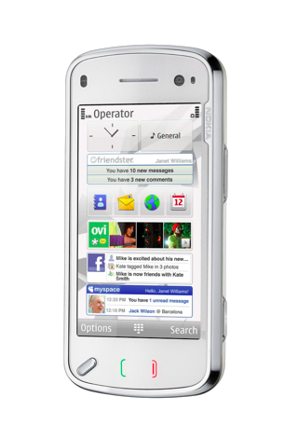

evaluation
C/C++ &
implemented on Nokia N97 and
iPhone in support of a speaker recognition app
Emiliano Miluzzo

Slide 102
evaluation
C/C++ &
implemented on Nokia N97 and
iPhone in support of a speaker recognition app
unix server
Emiliano Miluzzo

Slide 103
evaluation
C/C++ &
implemented on Nokia N97 and
iPhone in support of a speaker recognition app
lightweight reliable protocol to transfer models from the server and between phones
unix server
Emiliano Miluzzo

Slide 104
evaluation
C/C++ &
implemented on Nokia N97 and
iPhone in support of a speaker recognition app
UDP multicast protocol to distribute
local inference results between phones
Emiliano Miluzzo

Slide 105
experimental scenarios
up to eight people in conversation in three different scenarios (quiet indoor, down the street, in a restaurant)
Emiliano Miluzzo

Slide 106
some numerical results
Emiliano Miluzzo

Slide 107
need for evolution
train indoor, evaluate outdoor
Emiliano Miluzzo

Slide 108
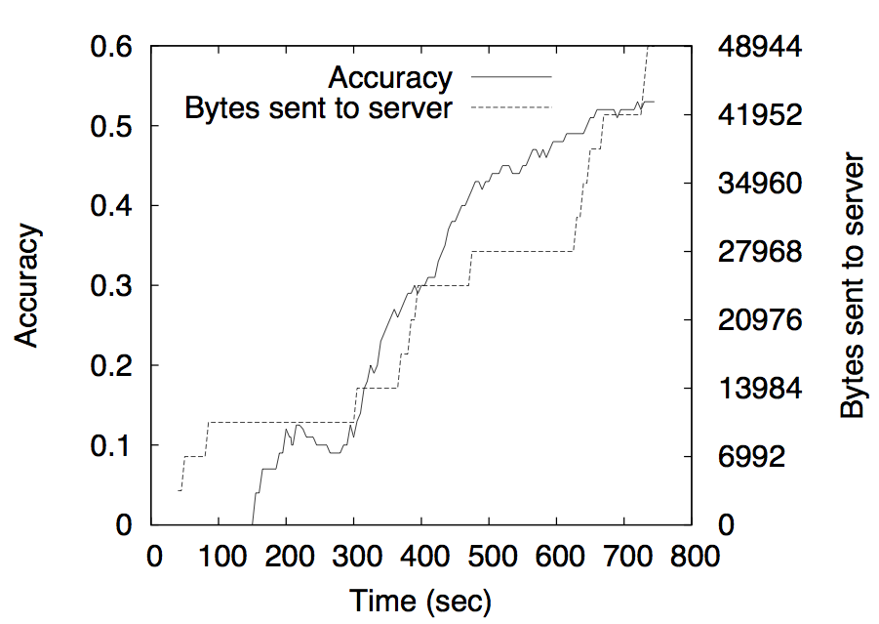
need for evolution
accuracy
accuracy improvement after evolution
Emiliano Miluzzo

Slide 109
indoor quiet scenario
8 people talking around a table
Emiliano Miluzzo

Slide 110
indoor quiet scenario
8 people talking around a table
Emiliano Miluzzo

Slide 111
indoor quiet scenario
8 people talking around a table
Emiliano Miluzzo

Slide 112
indoor quiet scenario
8 people talking around a table
Emiliano Miluzzo

Slide 113
indoor quiet scenario
8 people talking around a table
Emiliano Miluzzo

Slide 114
indoor quiet scenario
8 people talking around a table
Emiliano Miluzzo

Slide 115
indoor quiet scenario
collaborative inference +
classification model evolution
boost the performance of a mobile sensing app
8 people talking around a table
Emiliano Miluzzo

Slide 116
impact of the number of mobile phones
Emiliano Miluzzo

Slide 117
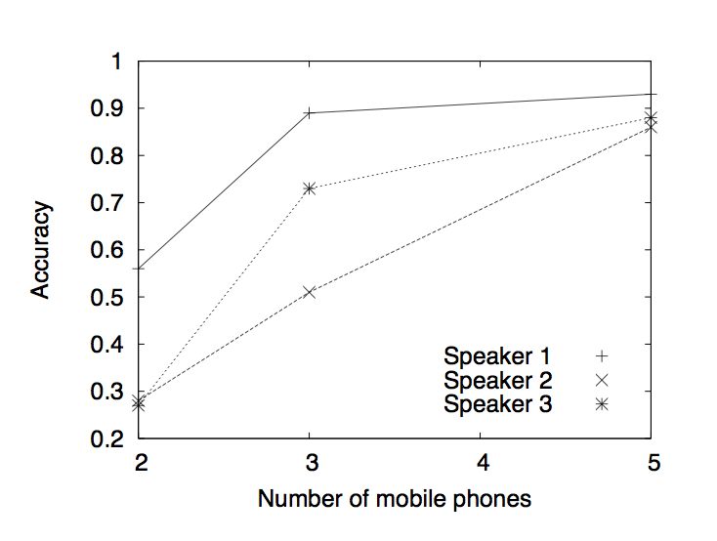
impact of the number of mobile phones
Emiliano Miluzzo

Slide 118
impact of the number of mobile phones
Emiliano Miluzzo

Slide 119
impact of the number of mobile phones
Emiliano Miluzzo

Slide 120
impact of the number of mobile phones
the larger the number of mobile phones collaborating, the better the final inference result
Emiliano Miluzzo

Slide 121
battery lifetime Vs inference responsiveness
Emiliano Miluzzo

Slide 122
battery lifetime Vs inference responsiveness
Emiliano Miluzzo

Slide 123
battery lifetime Vs inference responsiveness
high responsiveness
Emiliano Miluzzo

Slide 124
battery lifetime Vs inference responsiveness
short battery life
Emiliano Miluzzo

Slide 125
battery lifetime Vs inference responsiveness
longer battery duration
Emiliano Miluzzo

Slide 126
battery lifetime Vs inference responsiveness
low responsiveness
Emiliano Miluzzo

Slide 127
battery lifetime Vs inference responsiveness
smart duty-cycling techniques and machine learning algorithms with better performance in terms of energy usage on mobile phones need to be identified
Emiliano Miluzzo

Slide 128
a quick recap
smartphone’s are everywhere, let’s exploit their collective sensing and computation capabilities
Emiliano Miluzzo

Slide 129
a quick recap
smartphone’s are everywhere – let’s exploit their collective sensing and computation capabilities
smartphone sensing opens up new frontiers: applications can be spread and big data collected at unprecedented scale enabling endless research opportunities
Emiliano Miluzzo

Slide 130
a quick recap
smartphone’s are everywhere – let’s exploit their collective sensing and computation capabilities
smartphone sensing opens up new frontiers: applications can be spread and big data collected at unprecedented scale enabling endless research opportunities
continuous sensing is still challenging; efficient mobile sensing requires to preserve the phone user experience (need for energy efficient ML algorithms and smart duty-cycling techniques)
Emiliano Miluzzo

Slide 131
a quick recap
smartphone’s are everywhere – let’s exploit their collective sensing and computation capabilities
smartphone sensing opens up new frontiers: applications can be spread and big data collected at unprecedented scale enabling endless research opportunities
continuous sensing is still challenging; efficient mobile sensing requires to preserve the phone user experience (need for energy efficient ML algorithms and smart duty-cycling techniques)
ML algorithms should perform reliably in the wild
Emiliano Miluzzo

Slide 132
a quick recap
smartphone’s are everywhere – let’s exploit their collective sensing and computation capabilities
ok I think I’m done…
smartphone sensing opens up new frontiers: applications can be spread and big data collected at unprecedented scale enabling endless research opportunities
continuous sensing is still challenging; efficient mobile sensing requires to preserve the phone user experience (need for energy efficient ML algorithms and smart duty-cycling techniques)
ML algorithms should perform reliably in the wild
Emiliano Miluzzo

Slide 133
a quick recap
smartphone’s are everywhere – let’s exploit their collective sensing and computation capabilities
but please bear in mind…
smartphone sensing opens up new frontiers: applications can be spread and big data collected at unprecedented scale enabling endless research opportunities
continuous sensing is still challenging; efficient mobile sensing requires to preserve the phone user experience (need for energy efficient ML algorithms and smart duty-cycling techniques)
ML algorithms should perform reliably in the wild
Emiliano Miluzzo

Slide 134

Mobile Phone Sensing is the Next Big Thing!
Emiliano Miluzzo

Slide 135
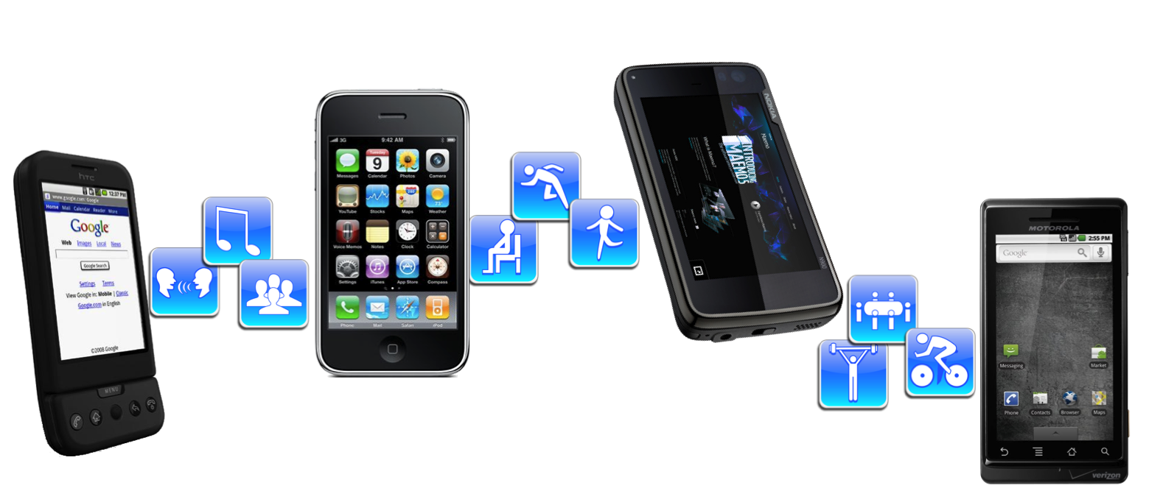
Thank you!!
Mobile Sensing Group
http://sensorlab.cs.dartmouth.edu
Emiliano Miluzzo

