Slide 1
EyePhone: Activating Mobile Phones With Your Eyes
Emiliano Miluzzo, Tianyu Wang,
Andrew T. Campbell
CS Department – Dartmouth College, Hanover, NH, USA

Slide 2
what is the future of sensing?
Emiliano Miluzzo

Slide 3
mobile phone sensing
Emiliano Miluzzo

Slide 4
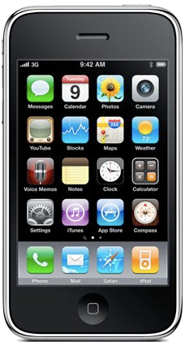
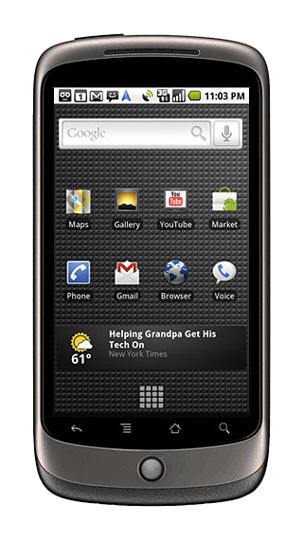
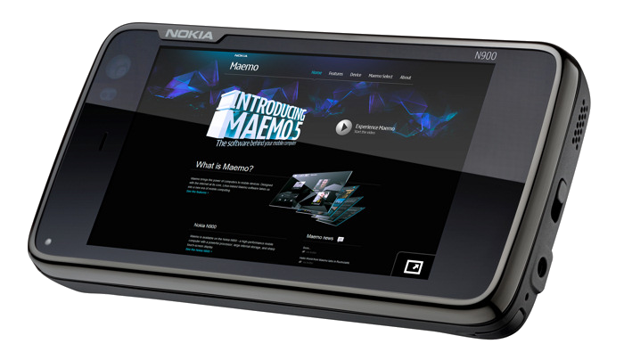
mobile phone sensing
Emiliano Miluzzo

Slide 5
mobile phone sensing
computationally capable
(up to 2GHz CPU and
1 GB RAM)
Emiliano Miluzzo

Slide 6
mobile phone sensing
….
accelerometer
air quality /
pollution sensor
digital compass
gyroscope
microphone
light sensor/camera
GPS
WiFi/bluetooth
Emiliano Miluzzo

Slide 7
mobile phone sensing
….
accelerometer
air quality /
pollution sensor
digital compass
gyroscope
microphone
light sensor/camera
light sensor/camera
GPS
WiFi/bluetooth
Emiliano Miluzzo

Slide 8
mobile phone sensing
….
accelerometer
air quality /
pollution sensor
camera
digital compass
gyroscope
microphone
light sensor/camera
light sensor/camera
GPS
WiFi/bluetooth
Emiliano Miluzzo

Slide 9
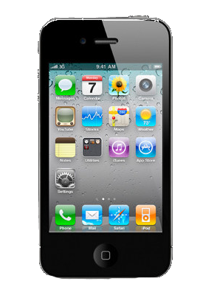
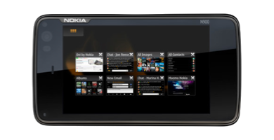
front facing camera
Emiliano Miluzzo

Slide 10
how can we use it?
Emiliano Miluzzo

Slide 11
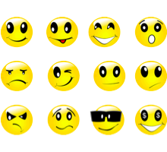
emotion assessment
Emiliano Miluzzo

Slide 12
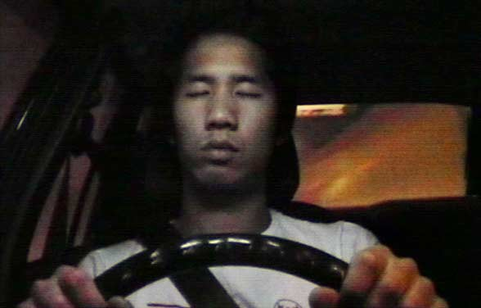
emotion assessment
in-car safety
Emiliano Miluzzo

Slide 13
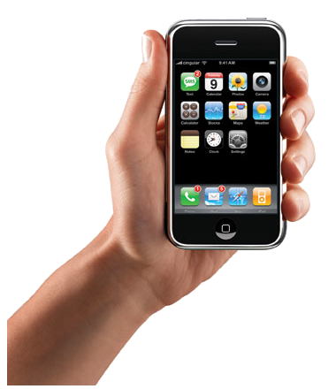
emotion assessment
in-car safety
human-phone interaction
Emiliano Miluzzo

Slide 14
why HPI?
Emiliano Miluzzo

Slide 15
because…
human-computer interaction - HCI
Emiliano Miluzzo

Slide 16
because…
human-computer interaction - HCI
human-phone interaction - HPI
Emiliano Miluzzo

Slide 17
because…
human-computer interaction - HCI
human-phone interaction - HPI
Emiliano Miluzzo

Slide 18
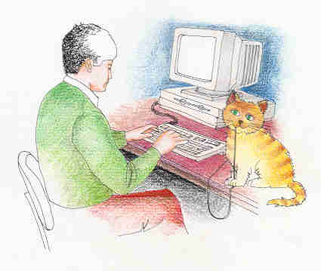
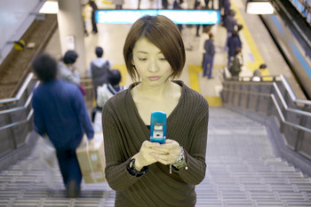
HCI
HPI
subjects are on the move (video frames are blurred)
limited sensing capabilities
not ideal sensing context (dark, bright, etc.)
hardware limitations
fairly ideal conditions for sensing
array of sophisticated sensors
subjects mostly static
“sensing context” fairly constant
Emiliano Miluzzo

Slide 19
EyePhone
Emiliano Miluzzo

Slide 20
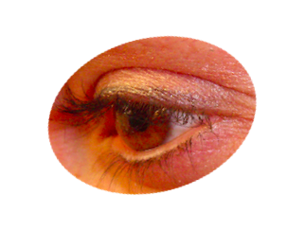
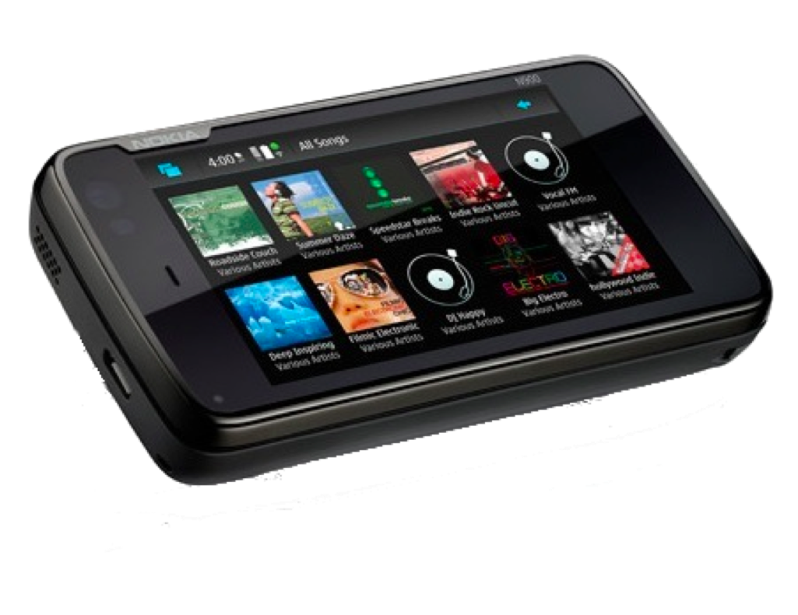
Emiliano Miluzzo

Slide 21
mapping the position of the eye to an application icon on the phone display
Emiliano Miluzzo

Slide 22
mapping the position of the eye to an application icon on the phone display
Emiliano Miluzzo

Slide 23
mapping the position of the eye to an application icon on the phone display
Emiliano Miluzzo

Slide 24
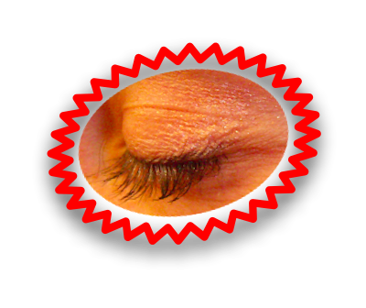
the selected application (e.g., music) is activated with a wink
Emiliano Miluzzo

Slide 25
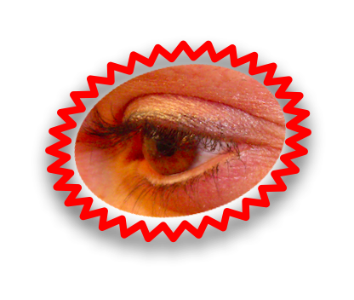
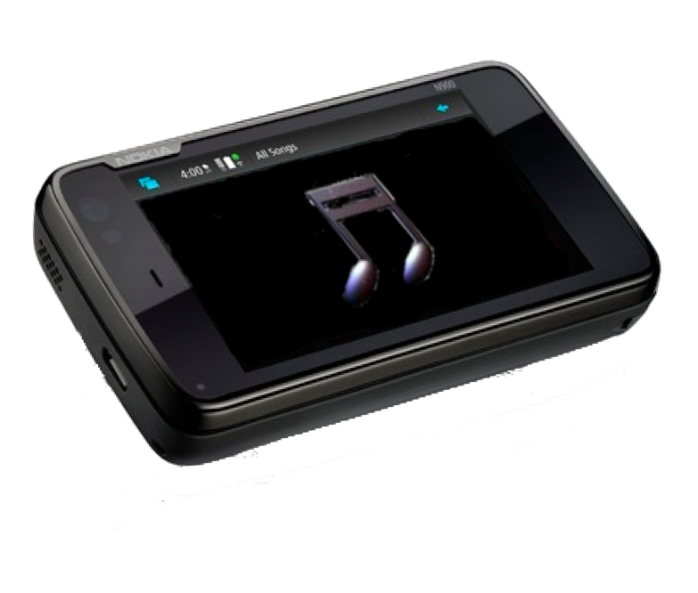
the selected application (e.g., music) is activated with a wink
Emiliano Miluzzo

Slide 26
EyePhone design
Emiliano Miluzzo

Slide 27
eye template creation
Emiliano Miluzzo

Slide 28
eye template creation
offline for different environments
Emiliano Miluzzo

Slide 29
eye template creation
image differencing over a set of frames capturing a
blink. The result is a binary image with the eye pair
offline for different environments
Emiliano Miluzzo

Slide 30
eye template creation
image differencing over a set of frames capturing a
blink. The result is a binary image with the eye pair
offline for different environments
running on pc
running on the N810
Emiliano Miluzzo

Slide 31
eye template creation
image differencing over a set of frames capturing a
blink. The result is a binary image with the eye pair
offline for different environments
eye tracking
Emiliano Miluzzo

Slide 32
eye template creation
image differencing over a set of frames capturing a
blink. The result is a binary image with the eye pair
offline for different environments
eye tracking
on every frame
Emiliano Miluzzo

Slide 33
eye template creation
image differencing over a set of frames capturing a
blink. The result is a binary image with the eye pair
offline for different environments
eye tracking
based on a correlation function operating over the
current frame and the template
on every frame
Emiliano Miluzzo

Slide 34
eye template creation
image differencing over a set of frames capturing a
blink. The result is a binary image with the eye pair
offline for different environments
eye tracking
based on a correlation function operating over the
current frame and the template
on every frame
Emiliano Miluzzo

Slide 35
eye template creation
image differencing over a set of frames capturing a
blink. The result is a binary image with the eye pair
offline for different environments
eye tracking
based on a correlation function operating over the
current frame and the template
on every frame
wink detection
Emiliano Miluzzo

Slide 36
eye template creation
image differencing over a set of frames capturing a
blink. The result is a binary image with the eye pair
offline for different environments
eye tracking
based on a correlation function operating over the
current frame and the template
on every frame
wink detection
based on the correlation function values used in the tracking phase
Emiliano Miluzzo

Slide 37
evaluation
Emiliano Miluzzo

Slide 38
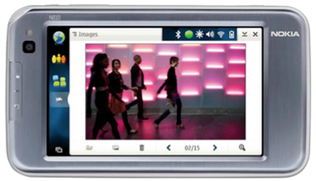
C++ & OpenCV
implemented on the Nokia Tablet 810
Emiliano Miluzzo

Slide 39
experimental results
Emiliano Miluzzo

Slide 40
accuracy
steady, daylight
Emiliano Miluzzo

Slide 41
accuracy
walking, daylight
Emiliano Miluzzo

Slide 42
accuracy Vs distance from display
Emiliano Miluzzo

Slide 43
accuracy Vs distance from display
Emiliano Miluzzo

Slide 44
possible applications?
Emiliano Miluzzo

Slide 45
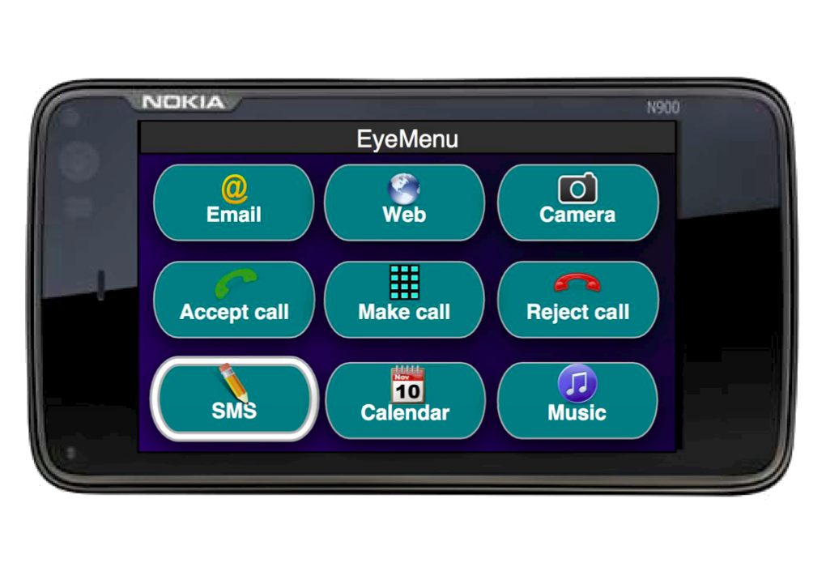
beyond touch screen…
Emiliano Miluzzo

Slide 46
let’s recap…
Emiliano Miluzzo

Slide 47
let’s recap…
smartphone’s computation capabilities are growing
Emiliano Miluzzo

Slide 48
let’s recap…
smartphone’s computation capabilities are growing
smarter open-eye template creation policies are needed
(to be robust across different context)
Emiliano Miluzzo

Slide 49
let’s recap…
smartphone’s computation capabilities are growing
smarter open-eye template creation policies are needed
(to be robust across different context)
need for eye tracking techniques that are robust against context, mobility, distance from display
Emiliano Miluzzo

Slide 50
let’s recap…
smartphone’s computation capabilities are growing
smarter open-eye template creation policies are needed
(to be robust across different context)
need for eye tracking techniques that are robust against context, mobility, distance from display
more efficient false eye pair and “false” winks filtering to avoid undesired app launches
Emiliano Miluzzo

Slide 51
in brief…
Emiliano Miluzzo

Slide 52
in brief…
mobile phone sensing and
HPI technology are the
future!
Emiliano Miluzzo

Slide 53
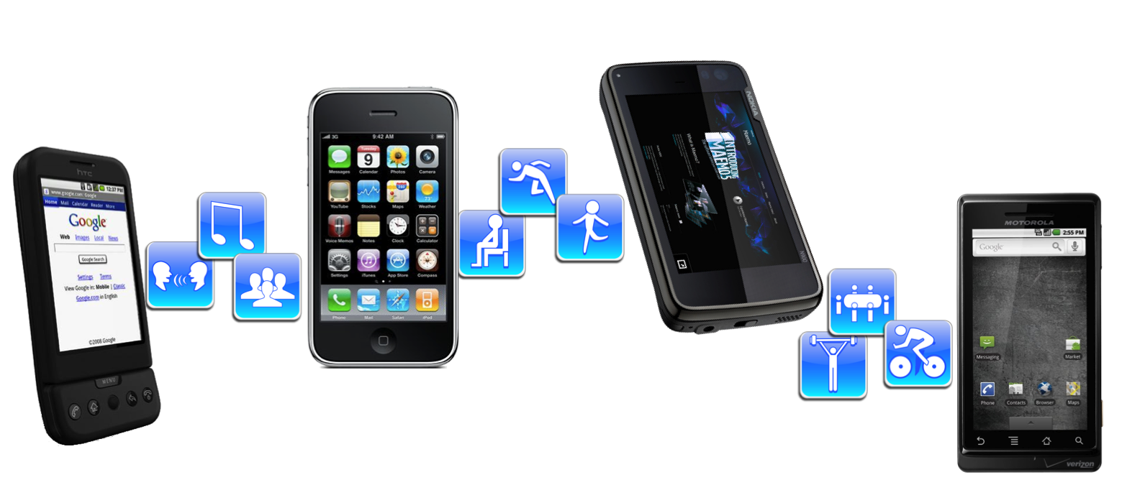
Thank you!
Mobile Sensing Group
http://sensorlab.cs.dartmouth.edu
Emiliano Miluzzo

